Slide 1
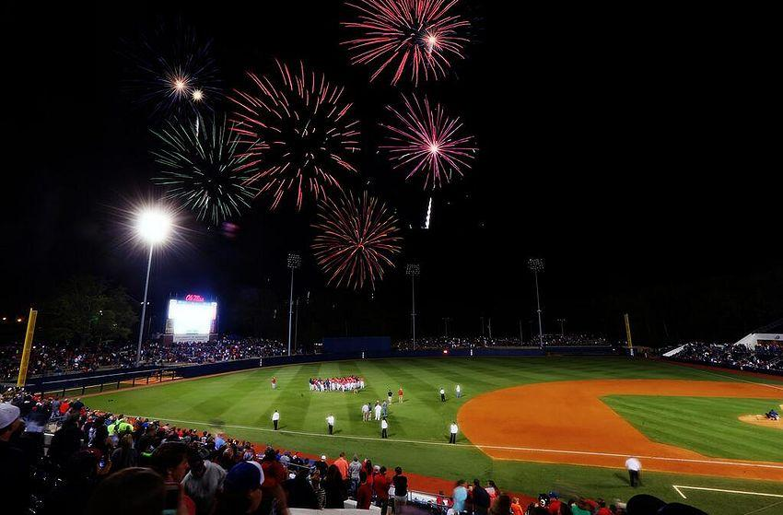
TEAM MLB
EVALUATION OF MLB SALARIES:
TEAM AND PLAYERS
Kevin Jordan
Vincent Wong
Bhavani Yella

Slide 2


Slide 3
Data Analysis
Data for 11 Years (1998-2008)
Team Salaries, Attendance, Performance measurement parameters such as: Wins, WARs, Winning Percentages, RA, RS, etc.
Batter Salaries, Performance Measurements Factors such as: HR, RBI, R, BA, OBP, SLG, etc.
Pitcher Salaries, Performance Measurements Factors such as: SO, Wins, WARs, HR, etc.
Data Format: CSV
Notes:
As Billy said this is an unfair game: Rich teams and Poor teams. This is what we want to analyse. Are the rich teams good and the poor teams to bad. Do the teams salaries depend on the performance or are there other factors.

Slide 4
Team Analysis
RICH TEAMS VS POOR TEAMS
Do the salaries of the teams (or players) depend on the wins/performance or are there other factors.
Our Assumption: Teams that perform better tend to have higher salaries.
Notes:
As Billy said this is an unfair game: Rich teams and Poor teams. This is what we want to analyse. Are the rich teams good and the poor teams to bad. Do the teams salaries depend on the performance or are there other factors.

Slide 5
Team Analysis
Are there any other factors apart from the performance contributing to the salary determination?
Viewers
Location
Team Players
Sponsors And Endorsements
Taxes
City and State Regulations
At the beginning of the 2011 season, the New York Yankees had the league’s highest payroll of $202,689,028. The league’s poorest team — the Kansas City Royals — had a payroll of only $36,126,000.
The New York Yankees highest paid athlete for that season was Alex Rodriguez who earned $32 million, almost as much as the entire Kansas City Royal’s payroll.
Luxury Tax or Competitive Balance Tax: It is a salary cap in order to level the spending an individual team can spend on their roaster. If a league lacks a salary cap, any rich team can spend all the money they can afford on players. Teams with smaller or poorer budget cannot keep up with the richer teams, as they can not afford the top talent, giving them the competitive disadvantage.

Slide 6
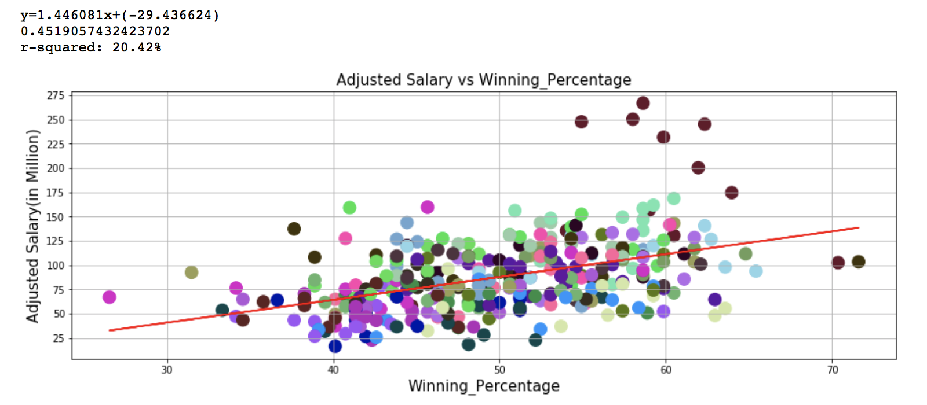
Winning Percentage Versus Salary
Notes:
We looked at the data for all 30 teams, you can see each team is color coded to identify the outliers. We realized NYY as an outlier. Meaning that does the winning percentage of NYY determine their salary??

Slide 7
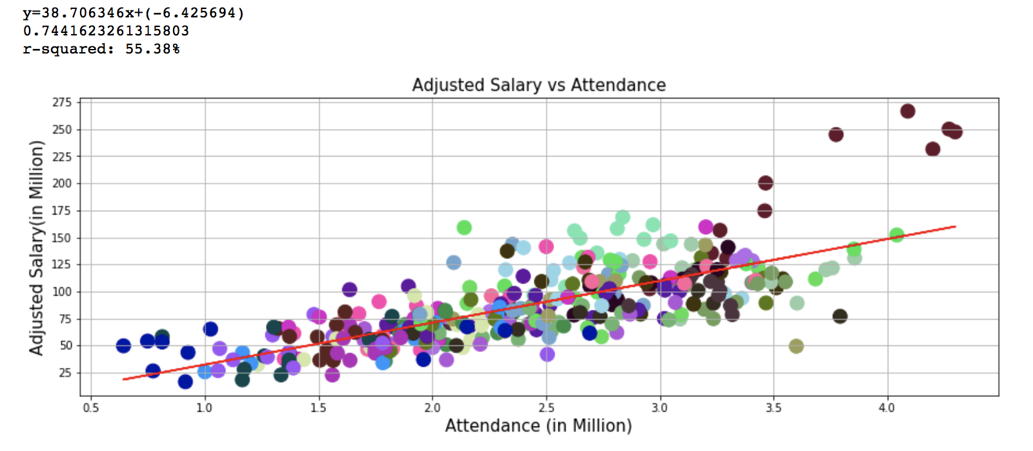
Attendance Versus Salary
Notes:
We noticed that the actual attendance of the viewers is more correlated to the team’s salary. The R value of 0.74 or R^2 value of 55.38%

Slide 8
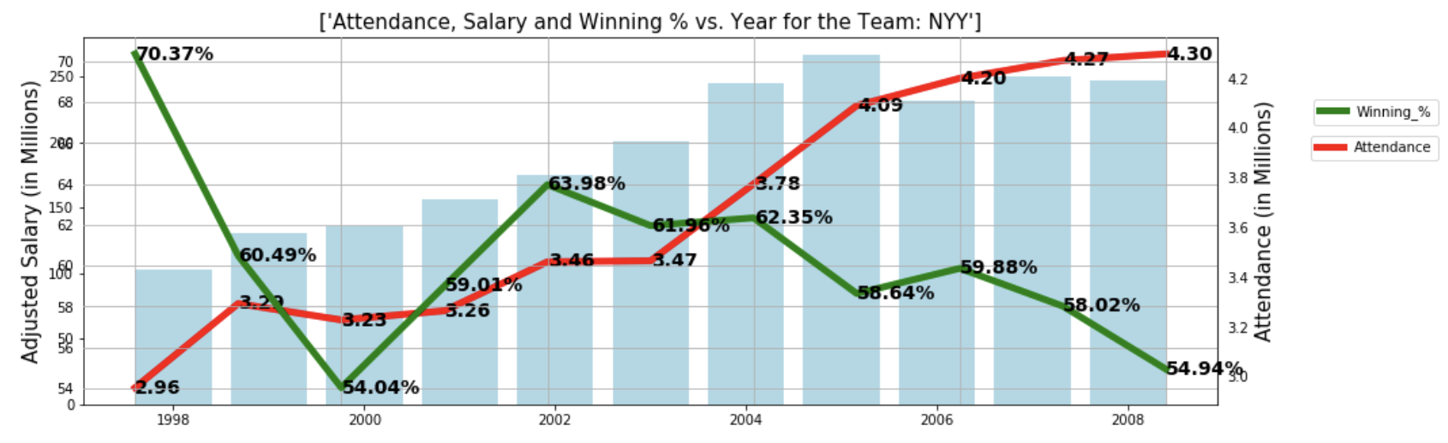
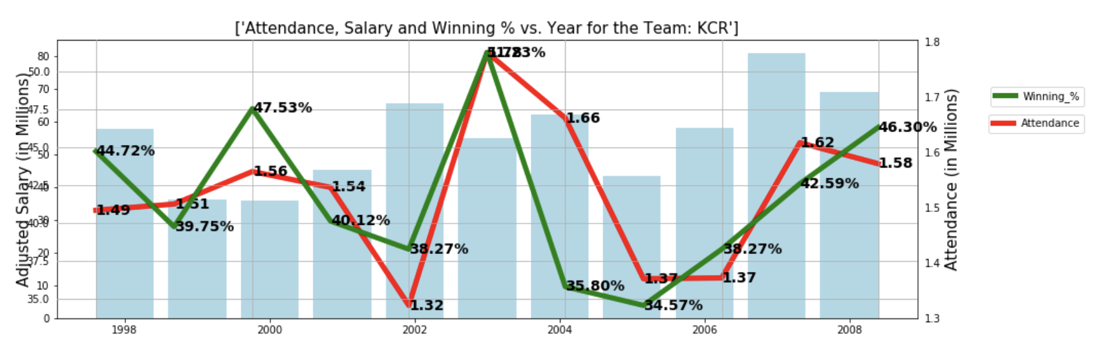
Comparison - NYY vs KCR

Slide 9
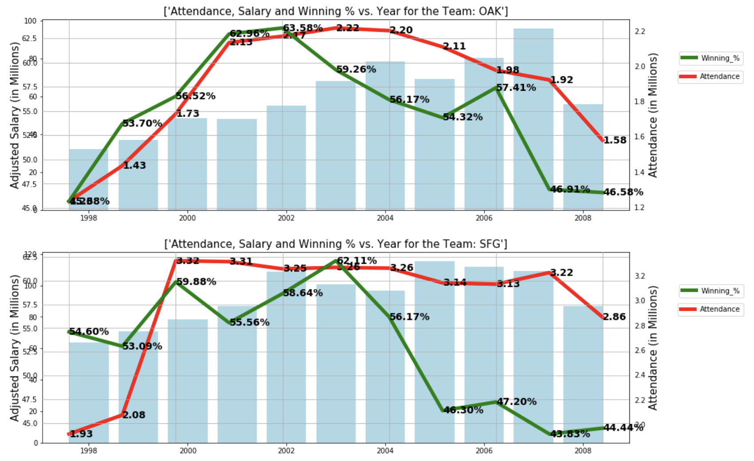
Oakland A’s and San Francisco Giants

Slide 10
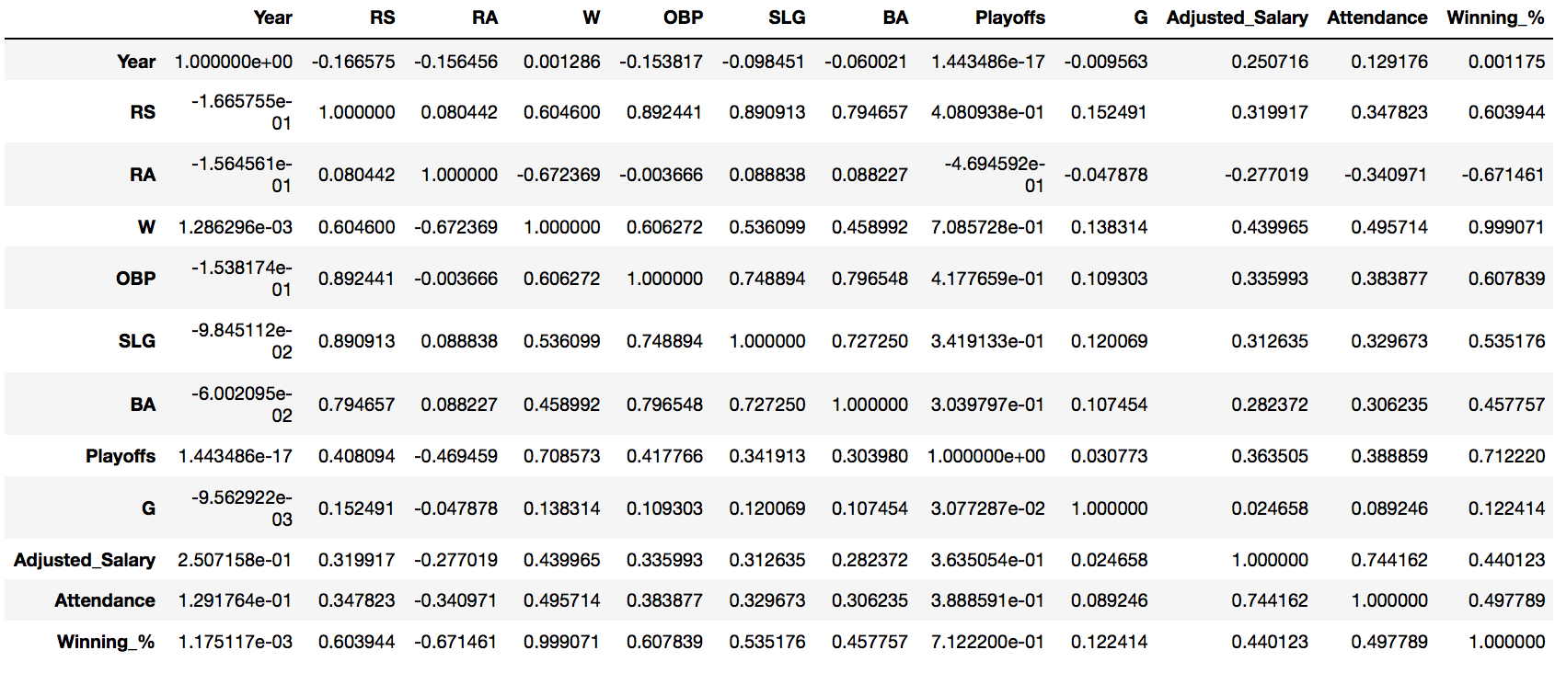
Correlation Matrix with Different Coefficients

Slide 11
Player Salary Analysis - Pitching
Normalized salary for inflation between 11 Years (1998-2008) using CPI (consumer price index) – takes out affect of raising salaries due to inflation
For player analysis: searching for explanatory variables (stats) to explain salary allocation (where are player’s salaries coming from?)
Statistics used for pitching:
Counting stats: Strike-Outs, Wins
Rate stats: ERA (Earned Run Average), WAR (Wins Above Replacement)
Only analyzed players who had more than 160 innings pitched, and who make more than the league minimum (excluding rookies and players under pre-arbitration)
Only looked at players in arbitration or free agency – pay for performance
Our Assumption: Pitchers who perform better in these categories will receive higher salaries

Slide 12
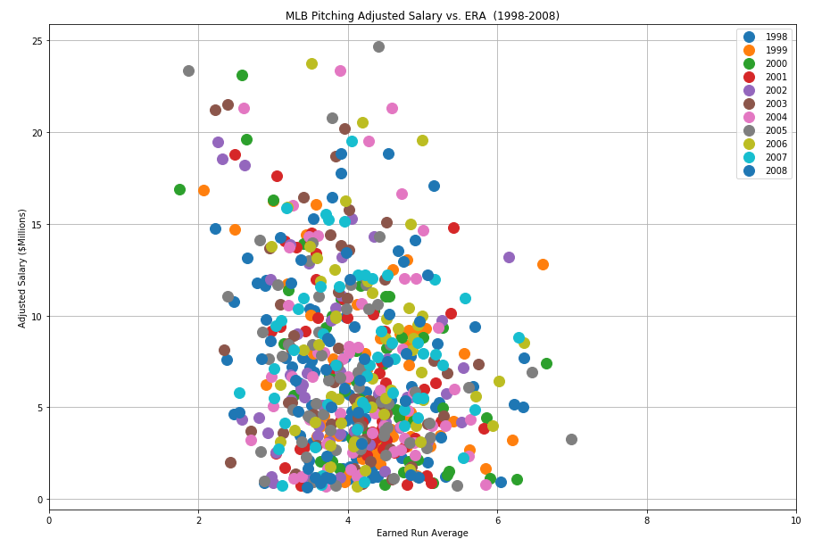
Pitching Rate Stats – Salary vs. ERA
Confounding effects
here with middle ERA performance
with highest salaries
Lower ERA is better performance for Pitchers
Negative Slope
Pitchers with low ERAs earn more $$$. There are no pitchers with low ERA with high salaries
Pitchers with high ERAs earn less $$$. There are no pitchers with high ERA with high salaries

Slide 13
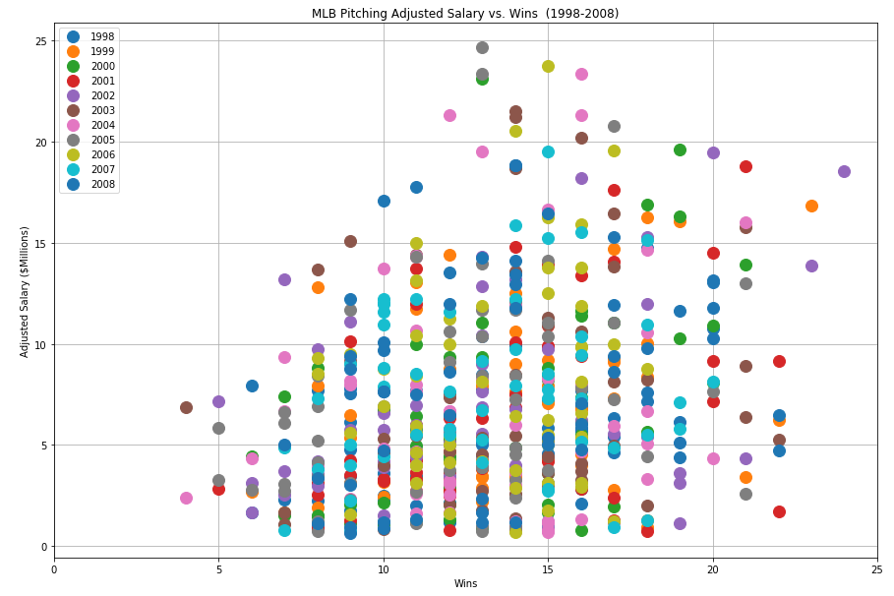
Pitching Rate Stats – Salary vs. Wins
162 total games
5 man rotation is common
16/32 = 50% winning
More Wins is better performance for Pitchers
Positive Slope
Pitchers with more wins generally earn more $$$. There are no pitchers with low wins with high salaries
There are other confounding factors as the highest salaries have 13-16 wins. Each pitcher usually 5 man rotation. 50% winning pitchers paid most.

Slide 14
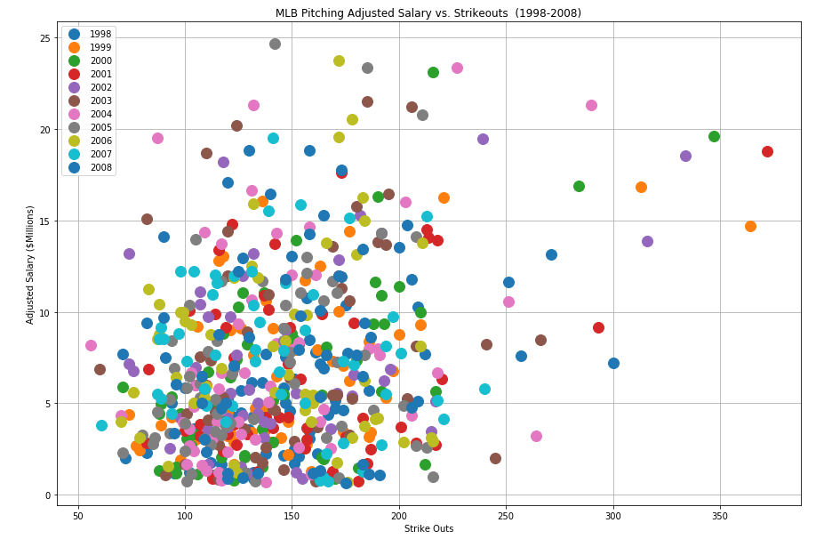
Pitching Rate Stats – Salary vs. Strike Outs (SO)
Strike outs not only factor
for pitchers.
More Strike Outs is better performance for Pitchers
Positive Slope
Pitchers with more SO generally earn more $$$. There are no pitchers with high SO with low salaries
There are other confounding factors as the highest salaries have 145-225 SO.
Empty

Slide 15
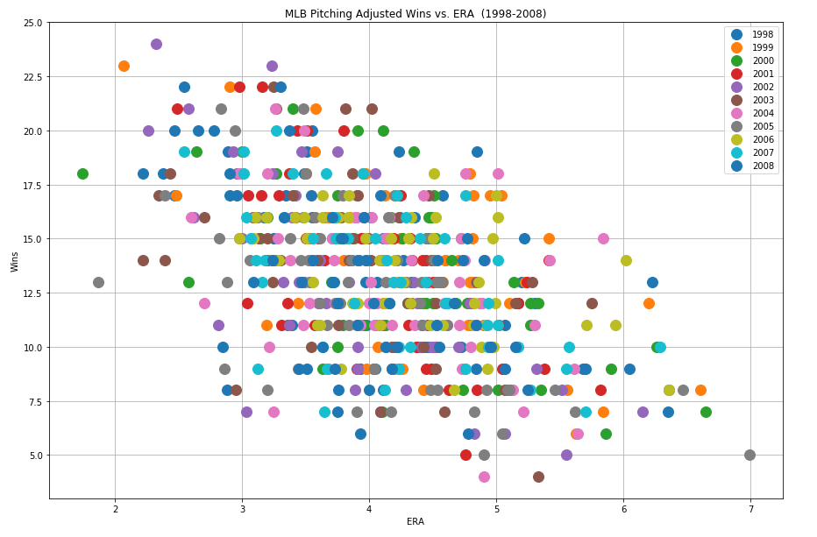
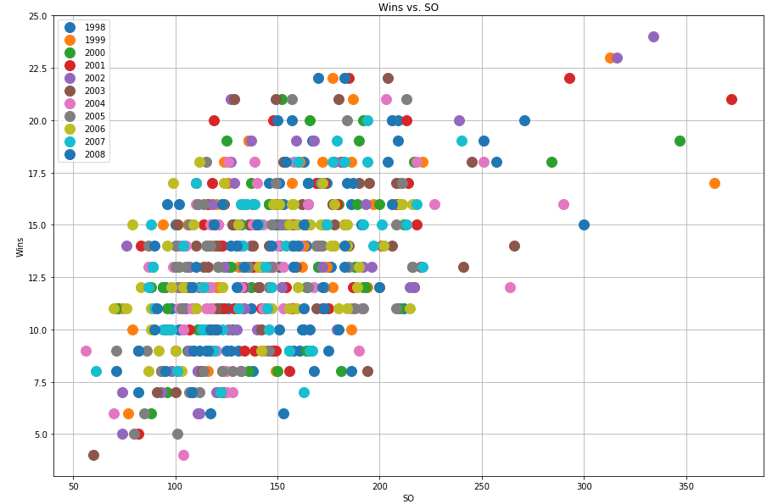
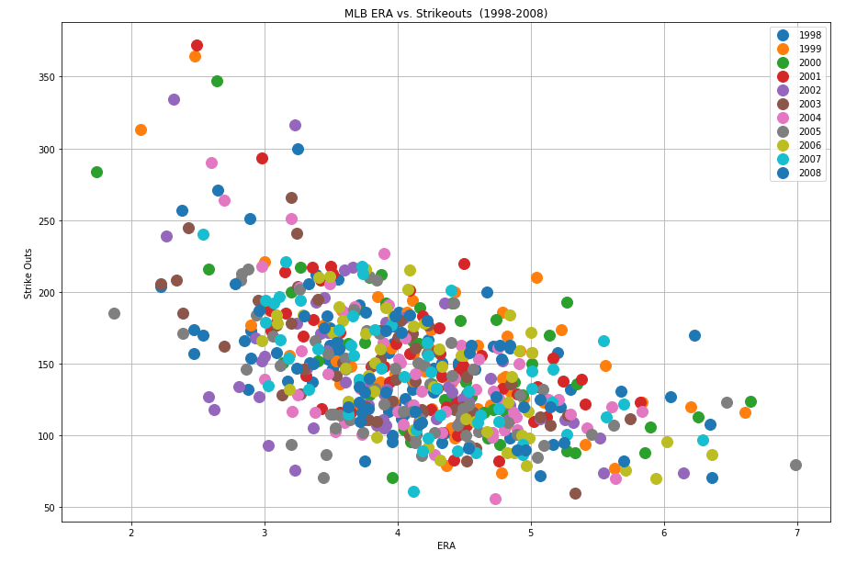
Pitching Rate Stats – Salary vs. Strike Outs (SO)
All pitcher performance metrics make sense
Wins vs. ERA
Lower ERA
More Wins
Wins vs. SO – More Wins with More SO
SO vs. ERA
More SO, lower ERA

Slide 16
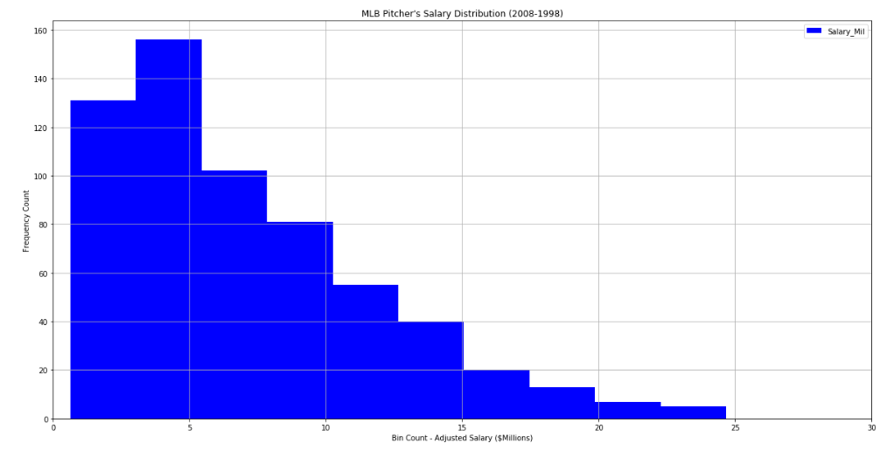
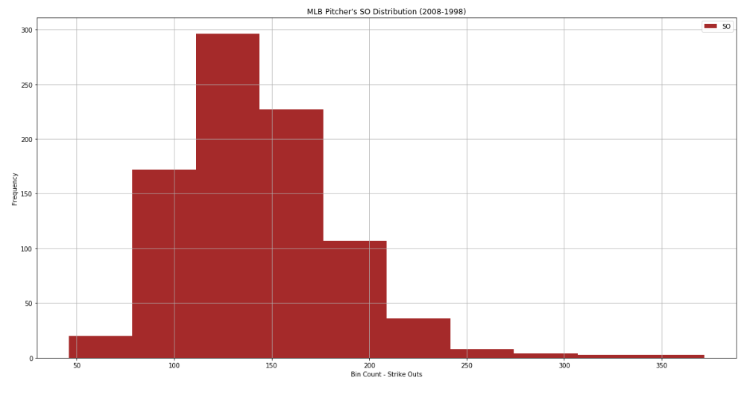
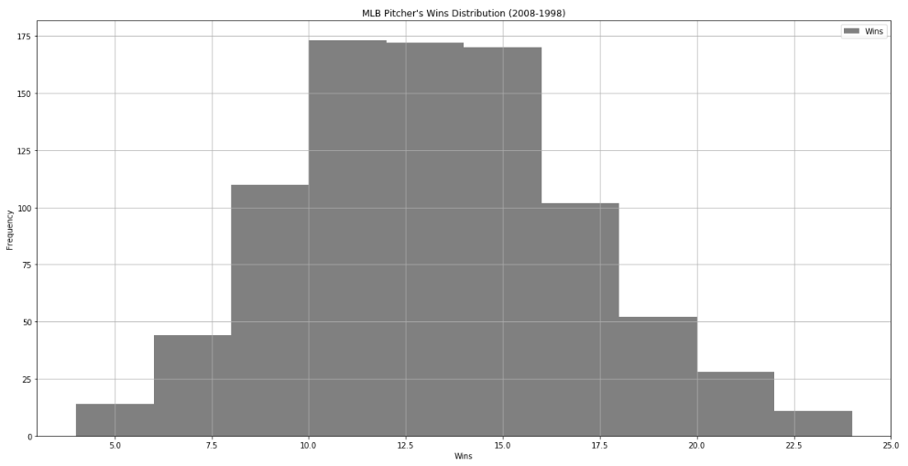
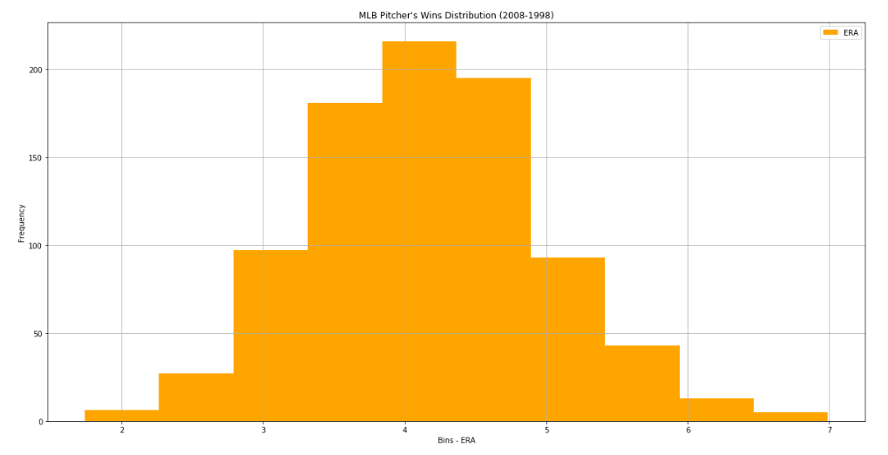
Pitching Stats - Histograms
Salary – Right Tail
Strike Outs –
Distributed shifted left
with extreme right tail
Making Most $$$
Wins – Top Hat
ERA – Top Hat
Most free agent pitchers win more than bell curve similar to ERA
Most free agent pitchers bunched up < $10M/yr salary quadrant

Slide 17
Player Salary Analysis - Batting
For player analysis: searching for explanatory variables (stats) to explain salary allocation (where are player’s salaries coming from?)
Statistics used for batting:
Counting stats: Hits, Home Runs, Runs Batted In (RBI), Runs Scored
Rate stats: Batting Average (BA), On Base Pct (OBP), Slugging Pct (SLG), OPS
Only analyzed players who had more than 400 Plate Appearances, and who make more than the league minimum (excluding rookies)
Our Assumption: Players who perform better in these categories will receive higher salaries (positive linear relationship)
Notes:
young players (under 26) are still under their first contract, and when they reach the majors they are paid the league minimum salary ($500K). If they perform very well, which many do, this can skew our results, so we took out players who made the league minimum to only analyze players who have been evaluated by the open market.

Slide 18
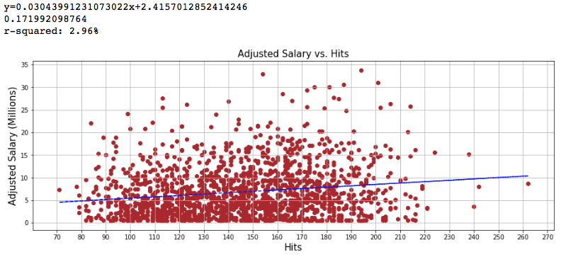
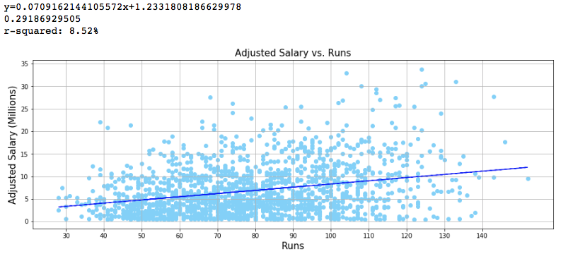
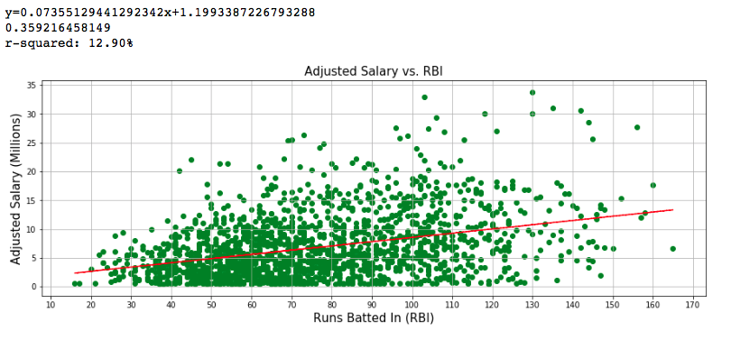
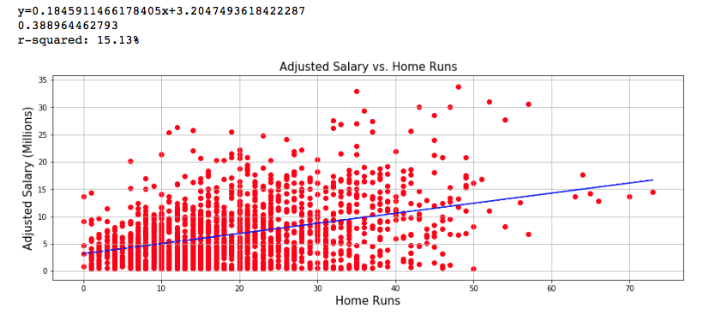
Counting Stats:
Notes:
HR is the most correlated (15% R-squared). However, data has high variance, looking at over 2000 entries, so none of the stats show a strong positive linear relationship. There is still some positive correlation, especially for the high performers

Slide 19
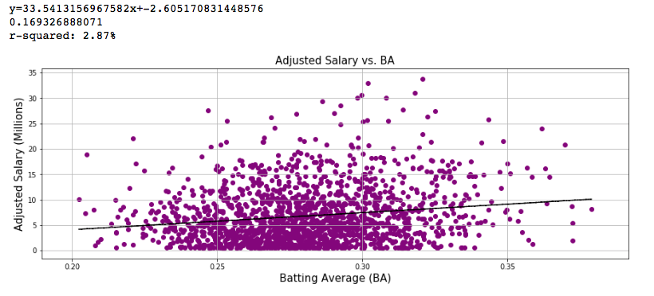
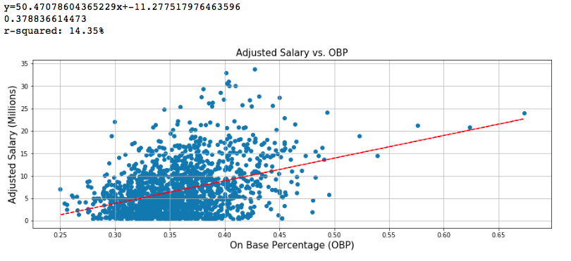
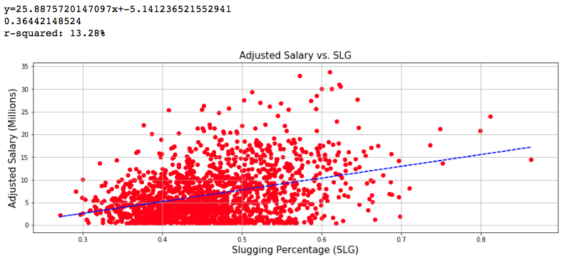
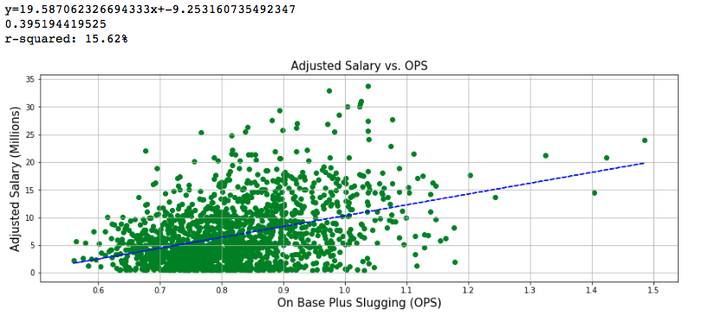
Rate Stats
Notes:
OPS has the strongest correlation of the rate stats (15% R-squared). Again, the data has a high variance and doesn’t show any strong positive linear relationship. There is still some positive correlation, especially for the high performers

Slide 20
Player performance vs team performance
Looked at 2 case examples (Barry Bonds and Alex Rodriguez)
HR, OPS, and WAR vs Win%
WAR - Wins Above Replacement
Limitations:
hitters don’t bat every time, so a team’s performance may not be very strongly related to an individual’s performance
Pitching performance isn’t included here either
Our Assumption: performing higher in these categories should be reflected in team performance
Notes:
WAR: an attempt to summarize a player's total contributions to their team in one statistic, essentially generating a number of wins he attributed to his team compared to if he were replaced with a replacement level player (0.0 WAR)

Slide 21
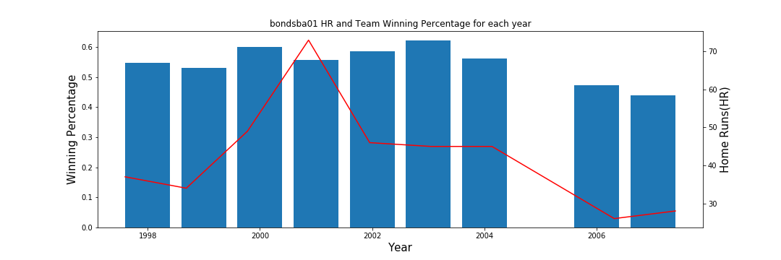
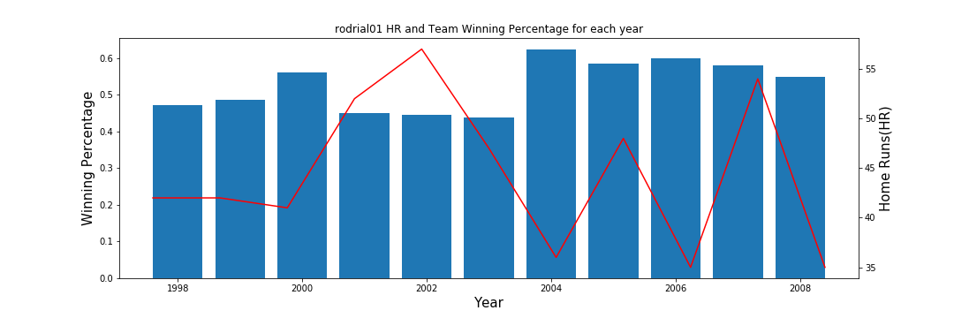
Home Runs-Barry Bonds (top) Versus Alex Rodriguez
Notes:
HR: Doesn’t seem to be a strong trend between HR and a team’s performance. Again, since a player hits once every 9 batters, it may be difficult to see any trends. Note: Bonds was injured and didn’t play enough to qualify in 2005.

Slide 22
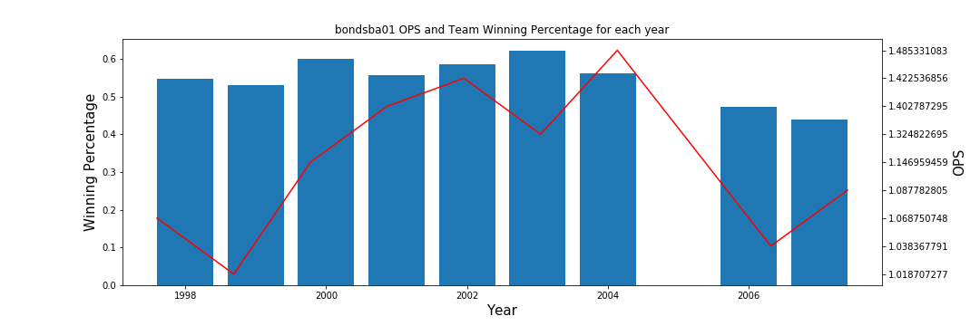
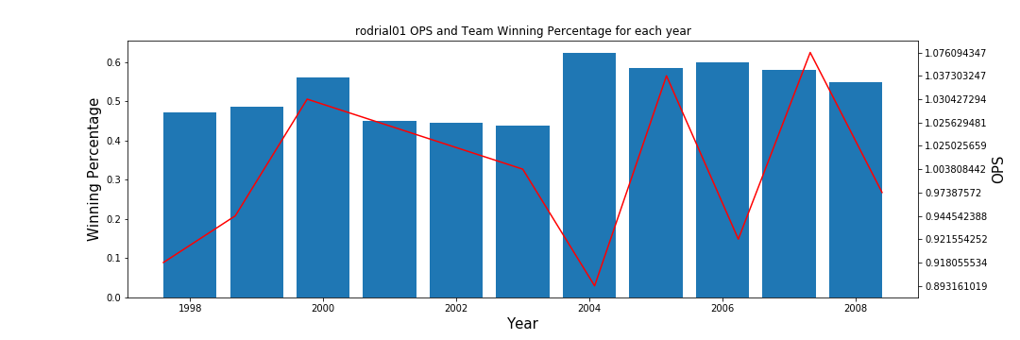
OPS-Barry Bonds Versus Alex Rodriguez
Notes:
OPS looks a little more closely related, especially for Barry Bonds (top).

Slide 23
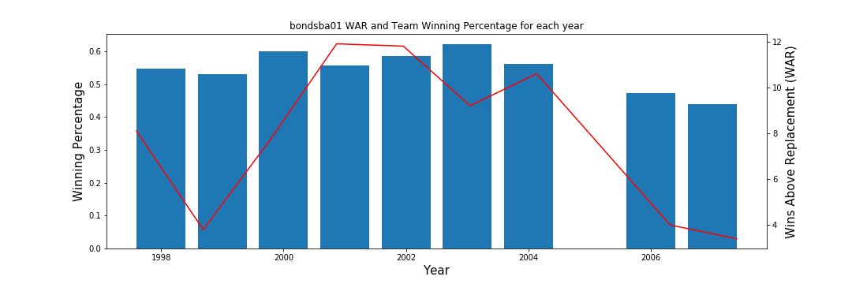
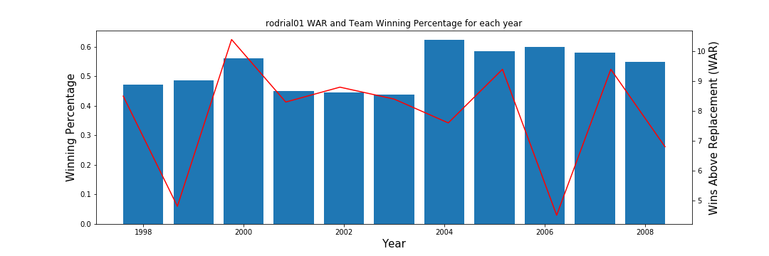
WAR-Barry Bonds Versus Alex Rodriguez

Slide 24
Expansions
Salary of highest paid player for each year (adjusted to present day value) vs. inflation or income
Team stats vs team performance (team HR, OPS, etc. vs W%)
Which metrics brings in the most revenue for teams? (wins, HR, RBI, etc.)
Player stats vs team runs per game (excludes pitching from team result)

Slide 25
Conclusion
Team Salaries: The correlation between team performance and salaries is not a strong correlation as we anticipated. Even though there is a linear positive correlation, there are other factors that drive the teams’ salaries. Salaries are strongly correlated to the attendance (no of the fans)
Batter Salaries: The relationship between batter performance and their salaries is not as strong as we expected. Despite some linear positive correlation, there are definitely other factors influencing batters’ salaries.
Pitcher Salaries: The relationship between pitcher performance and their salaries show general trends consistent with good vs. poor performance. However, there are confounding effects which show there are some of the highest paid pitchers actually are above average on all 3 metrics – ERA, SO, and Wins. The performance metrics of ERA, SO and Wins are all self-consistent.

